Slide 1
Viral Visualizations: How Coronavirus Skeptics Use Orthodox Data Practices to Promote Unorthodox Science Online
Muhammad Raees
Utkarsh Avadhut Dabholkar

Slide 2
Introduction
COVID breakthrough visual analytics as data visualization and dashboards reached common people.
Controversial understanding of COVID turned data visualization into a battleground in a war of deeply held beliefs.
The paper shows how the skeptics of COVID have used data visualization and digital media to spread misinformation and anti-mask beliefs.
COVID data visualizations reflect a deep sociopolitical rift regarding the place of science in public life.

Slide 3
Impact of Data Visualization
Visualizations—far from an objective representation of knowledge—are often, in fact representations of power.
People campaign against public health officials and visualizations show that government response is excessive and crisis is over.
People who do not trust the scientific evidence often deploy the same rhetorics of data-driven decision-making, but to advocate for radical policy changes.
This is an epistemological gap that leads to inferences from similar data reflecting a deeper socio-political rift.
So, what does the data-driven approach really means

Slide 4
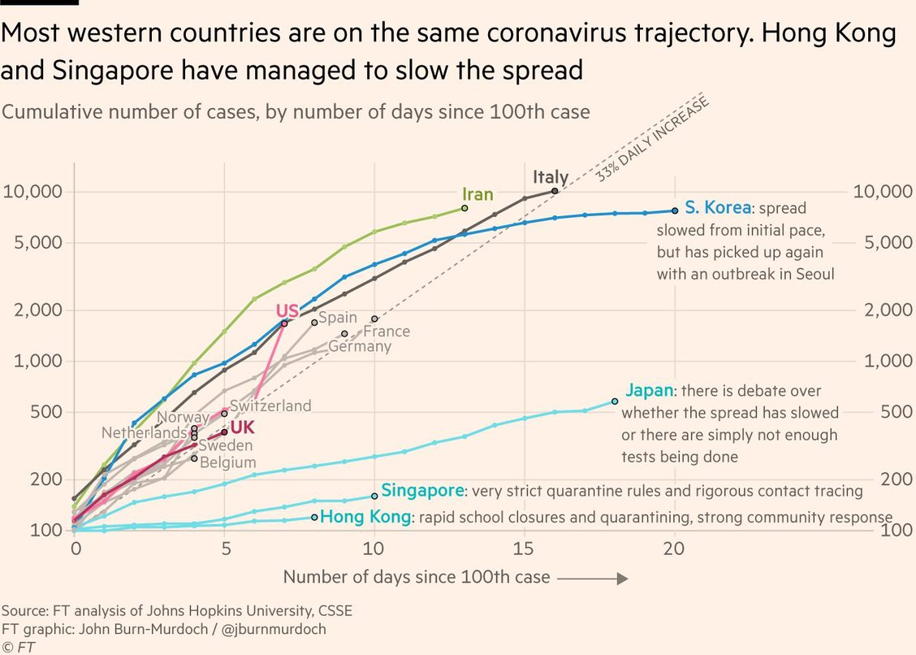
John Burn-Murdoch’s line chart comparing infection rates across countries helped millions of people make sense of the pandemic’s scale

Slide 5
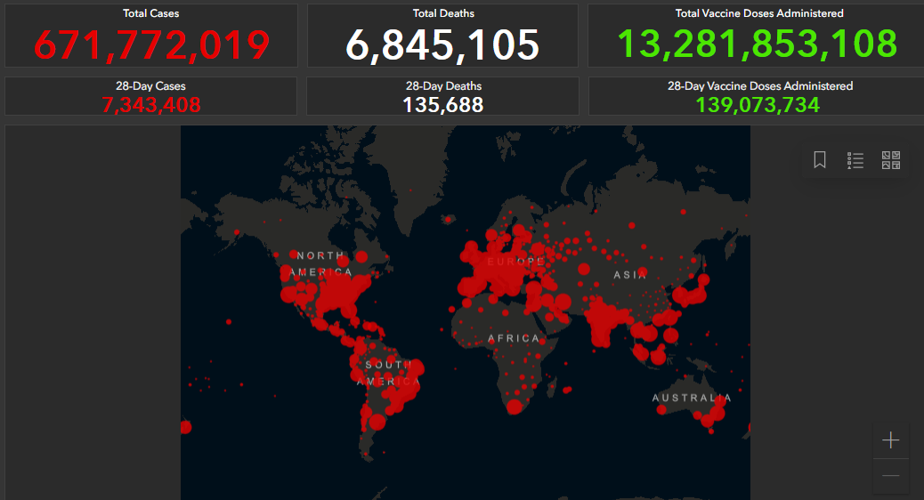
Trump administration officials seemed to rely heavily on the Johns Hopkins University COVID data dashboard

Slide 6
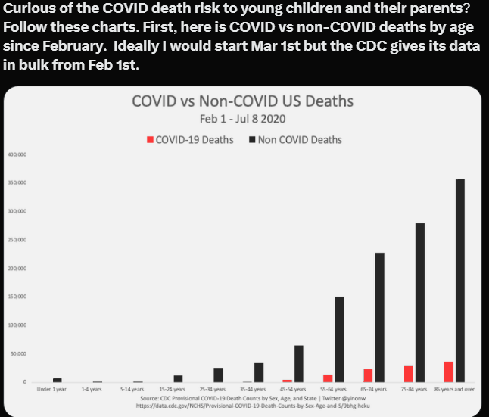
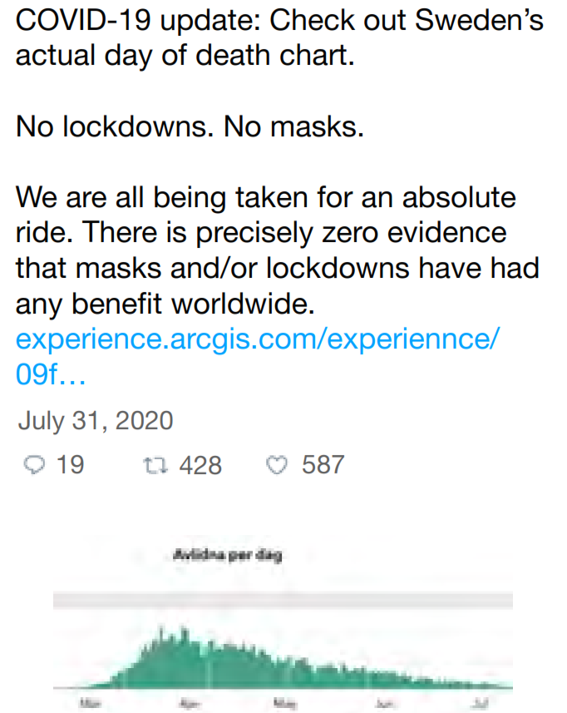
Counter Visualization

Slide 7
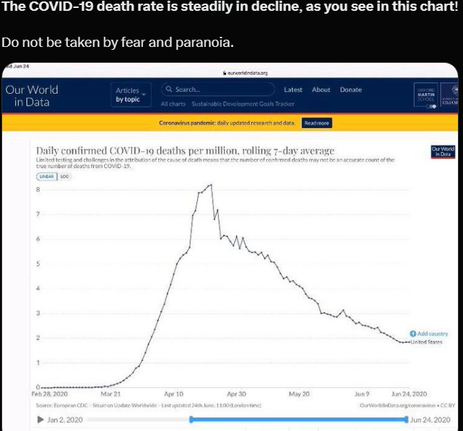
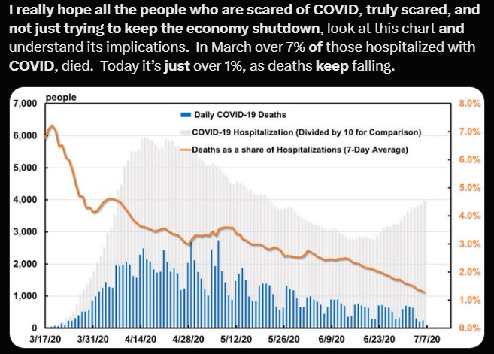
Is the pandemic an exaggerated ?

Slide 8
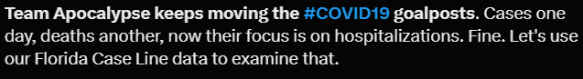
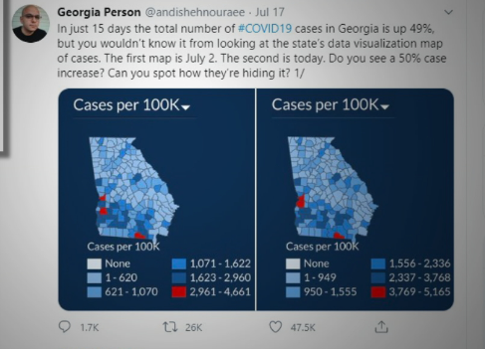
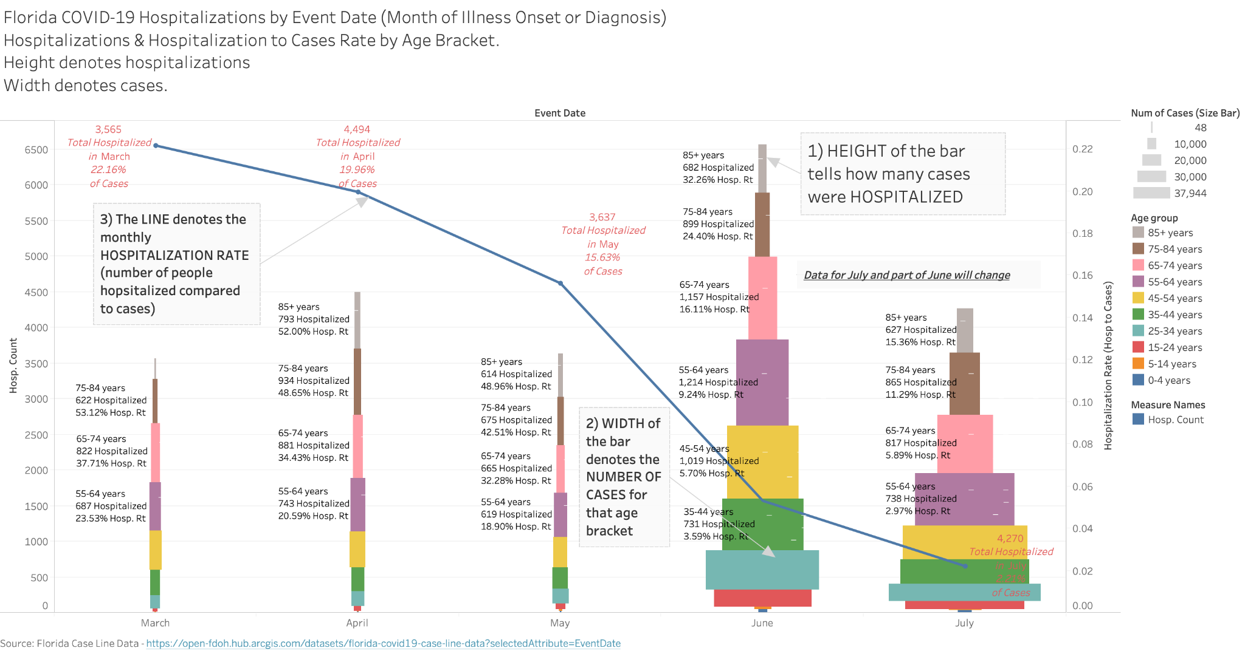
Is the pandemic an exaggerated ?

Slide 9
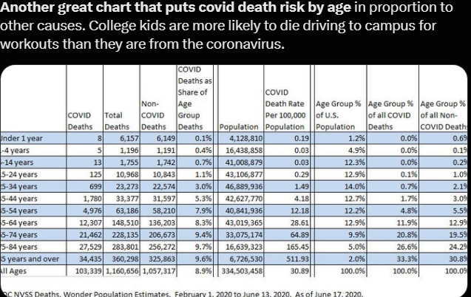
More examples

Slide 10
IMPLICATIONS
What is compelling here is the emphasize on “following the numbers” where people use the same data from CDC and WHO to reach radically different conclusions.
Protestors argued governments to overturn mask mandates and reopen schools and businesses.
A pandemic that affects a fews
Should not end liberties of a majority to go about life as usual.
Now, every state hosts a data dashboard on their health department website to show how the pandemic is unfolding, but the rift is deeper than just dashboards.

Slide 11
Rationale
Activist networks use rhetorics of scientific rigor to oppose public health measures.
Ignore scientific evidence to argue for individual freedom.
Engage with public datasets and make counter visualizations.
Challenge mainstream narratives of ongoing pandemic is urgent.
The quality of counter-visualizations is as good as the visualizations that in scientific and health department reports.
These groups argue for open access to government data.
CDC and local health departments are not releasing enough data for citizens to make informed decisions.

Slide 12
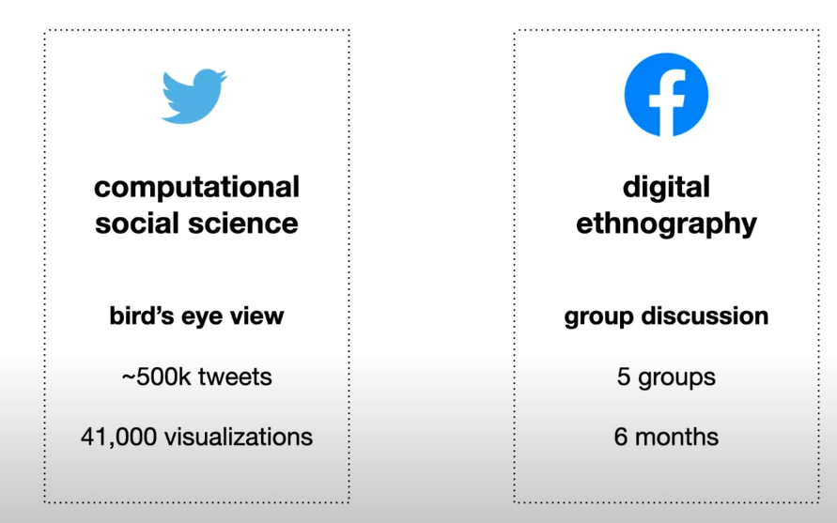
Study Methods

Slide 13
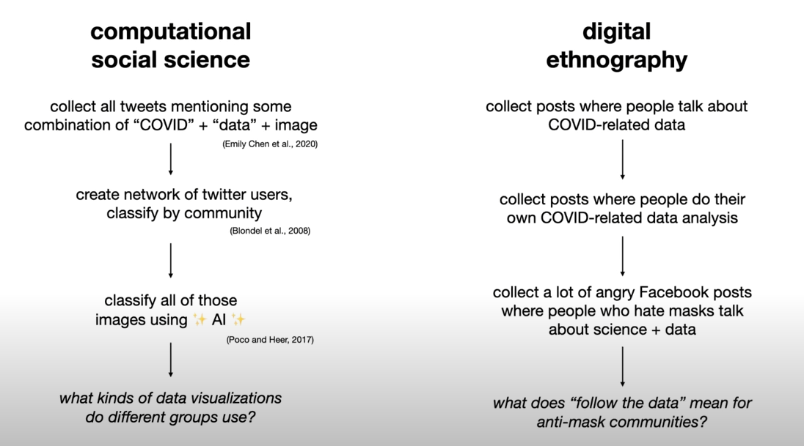
Study Methods

Slide 14
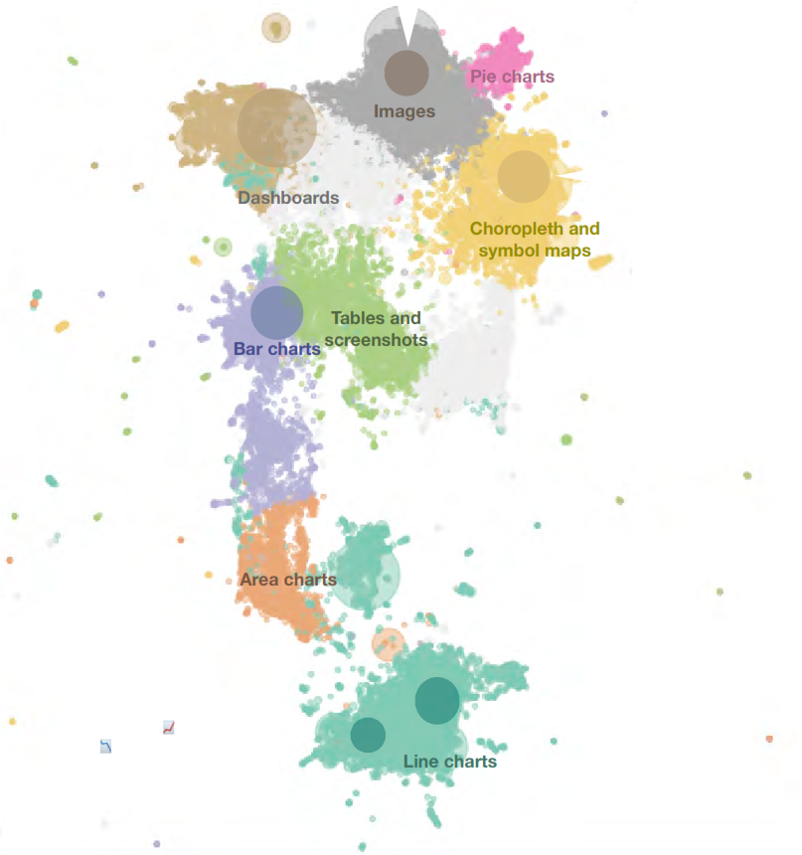
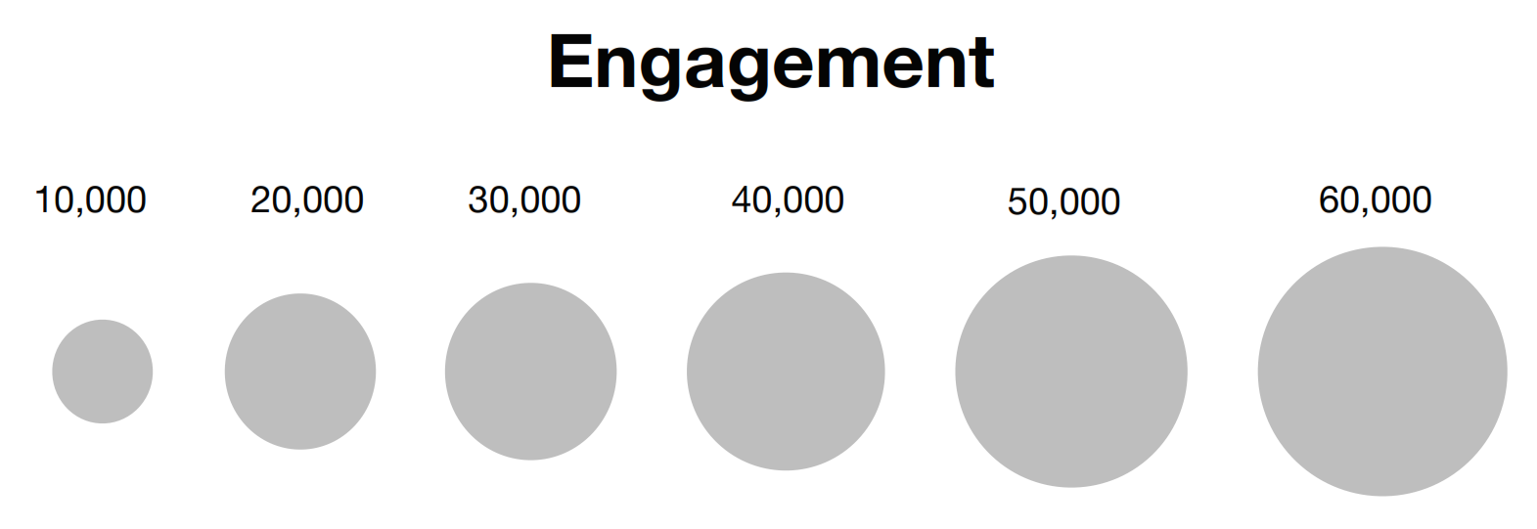
UMAP visualization that identifies the types of visualizations that proliferate on Twitter

Slide 15
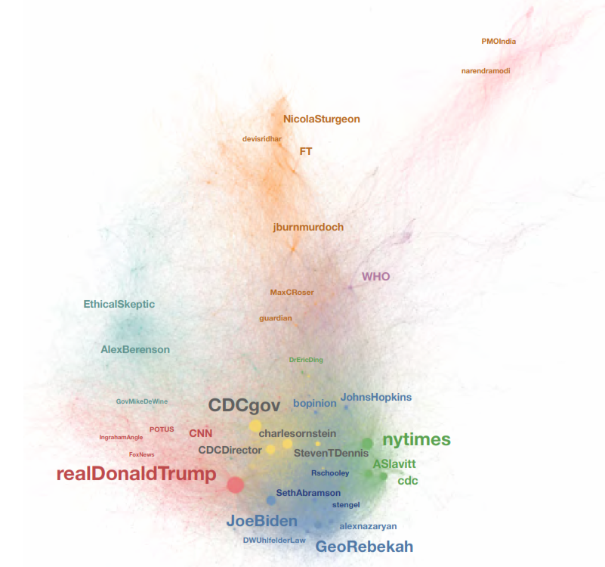
Network graph
Users who share and interact with these data visualizations; the edges that link users in a network together are retweets, likes, mentions
A graph of the tweets with 400,000 nodes and 583,000 edges
Filtering a smaller graph of influential actors, leading to 28,000 nodes and 104,000 edges
Identified six main communities

Slide 16
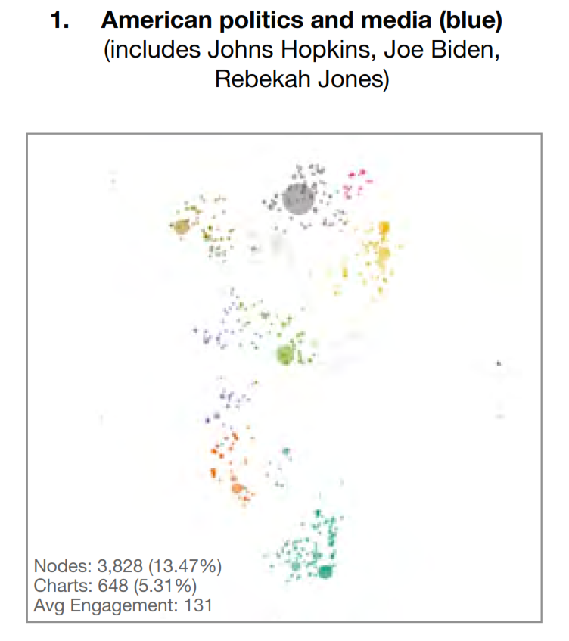
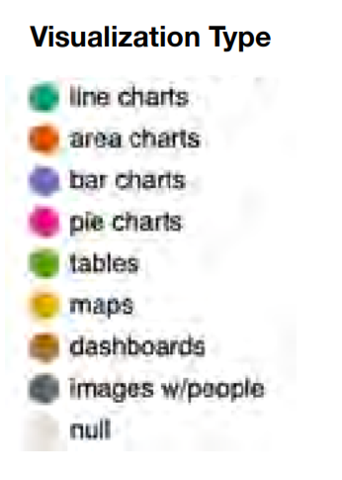

Slide 17
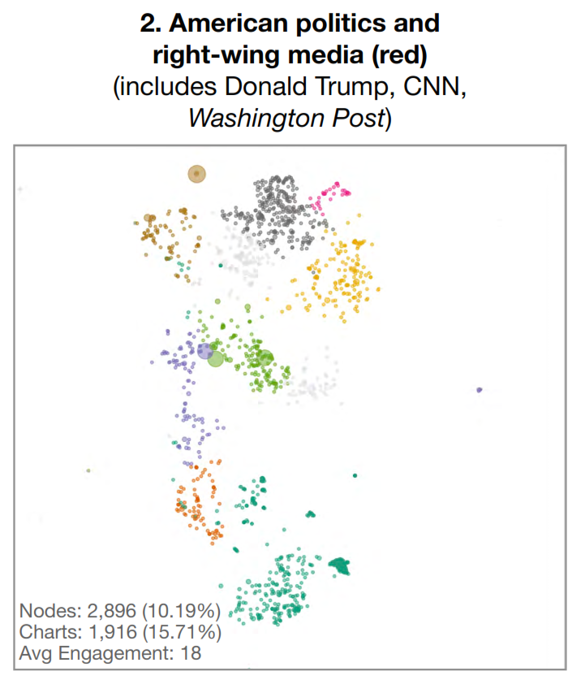

Slide 18
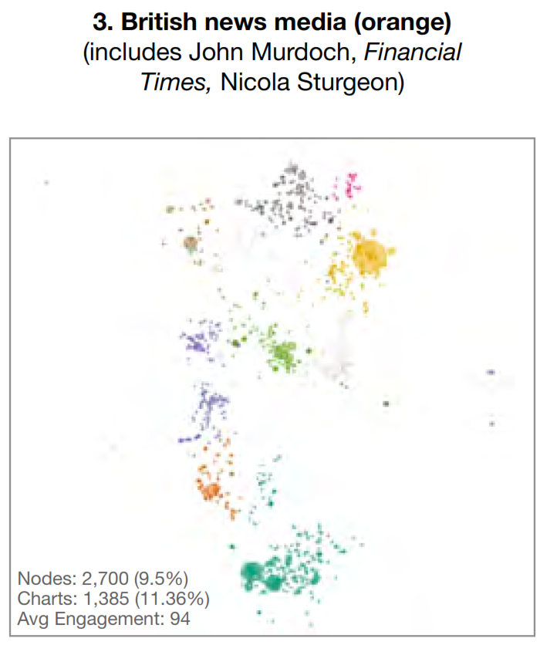

Slide 19
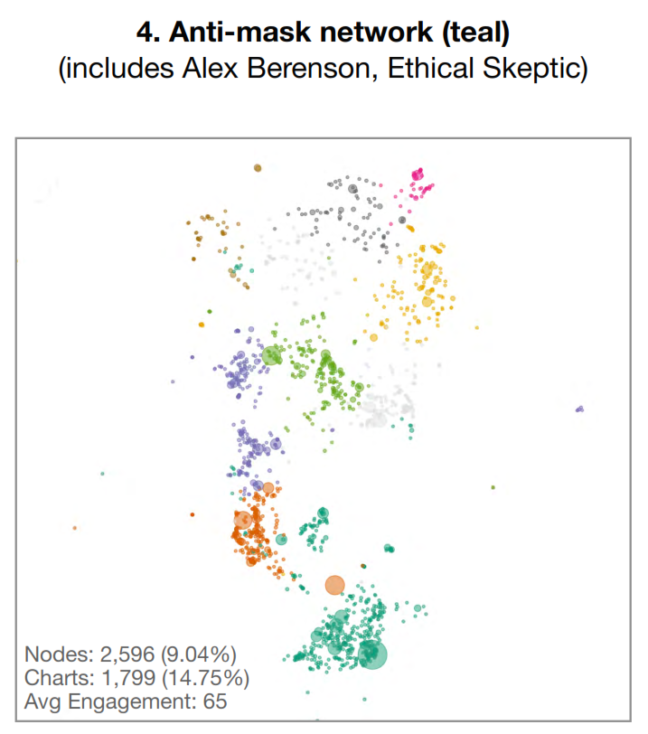

Slide 20
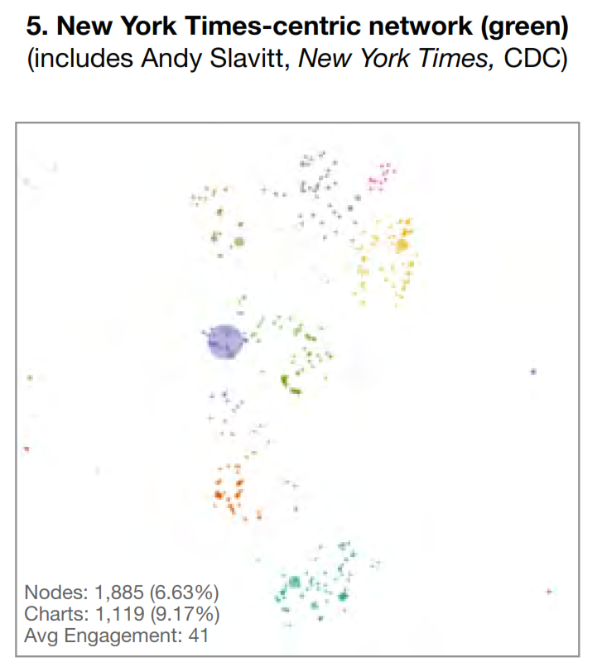

Slide 21
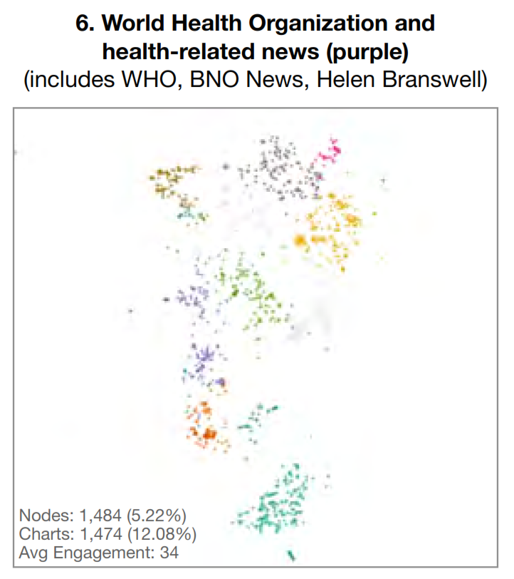

Slide 22
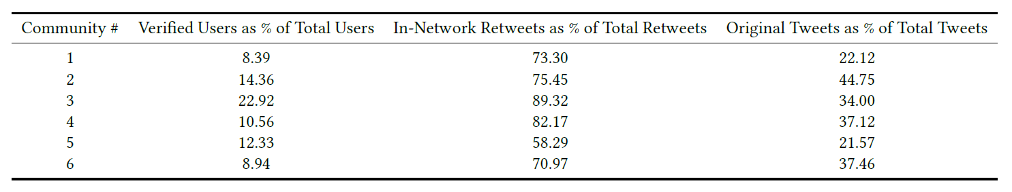
Analysis of Clusters

Slide 23
Findings
Mainstream and anti-mask visualizations are similar in terms of sophistication.
Percentage of verified users (suggesting anti-maskers are not bots).
Anti-maskers share the 2nd-highest number of charts across the top six communities
Most prolific producers of area/line charts
High percentage of in-network tweets
Share the fewest number of photos (memes and images of politicians).
The user with the most followers in group 2 is @BarackObama, while in group 4 it is @elonmusk.
Anti-maskers fill information gaps where localities can’t afford to develop a sophisticated web presence.

Slide 24
Counter Argument
A quantitative overview does not in itself helps to understand how anti-maskers use data and scientific reasoning to support policies like reopening schools and businesses.
Mainstream narratives use data to underscore the pandemic’s urgency.
Misinform that these data sources and visualizations are fundamentally flawed and counteract these biases promoting scientific methods.

Slide 25
Emphasize on original content
Anti-mask users express mistrust for academic and journalistic accounts of the pandemic,
Prohibit the sharing of non-original content so that discussions can be “guided solely by the data.”
Impose news consumption bans on themselves so that “mainstream” models do not “cloud their analysis.”
Anti-maskers value unmediated access to information and privilege personal research and direct reading over “expert” interpretations.

Slide 26
Assessing Data Sources
Critical about the circumstances under which the data are collected and distributed.
Important metrics are missing from government-released data (e.g., deaths, not cases)
Case rates are easily “manipulated” (e.g., with increased testing) and do not necessarily signal severe health problems (people can be asymptomatic).
Governments are deliberately withholding data so that they can unilaterally make decisions about whether or not lockdowns are effective.
Make the entire contact tracing process public i.e., where it started
Datasets are constructed by institutions lacking authenticity.
The lack of transparency within these data collection systems—which many of these users infer as a lack of honesty.

Slide 27
Data Representations, Bias & Scientific Authority
Specific types of visualizations can obscure or highlight information.
Absolute death counts as opposed to deaths per capita
Specific profit motives that come from releasing (or suppressing) specific kinds of information. E.g., Vaccines
Anti-maskers seek ways to validate their findings through the scientific establishment.
Collective analysis of data brings communities together
Transparent and dispassionate data analysis is crucial for democratic governance.

Slide 28
What Differs from scientific orthodoxy
Sleights of hand in variables without expert judgement (e.g., cases vs deaths, faulty testing, asymptomatic vs. symptomatic).
No lived experience, only statistical analysis.
Do not know a person who has experienced COVID
Believe that science must be accessible to them, no need of peer review.
Drop the biased data (they think) completely.
Deaths are problematic because doctors are using a COVID diagnosis as the main cause of death. When in reality there are other factors at play.
Show a resentment, scientists are usurpers who expect intellectual subservience rather than critical thinking from lay public

Slide 29
Visualizations won't cure
Increasing data access quality of data visualizations is not enough to support public consensus about scientific findings.
Counter-visualization (anti-masks) are aspects of resisting the tyranny of institutions usurp individual liberties to think freely and act accordingly.
Acceptance/reporting of uncertainty in visualizations by scientific authorities reflect distrust of the scientific establishment
CDC’s initial public messaging that masks were ineffective—followed by a quick public reversal.
Supporting public health measures requires a sustained engagement with visualizations and the people who make or interpret them.

Slide 30
Conclusions
Shift from positivist to interpretivist frameworks in visualization research.
Recognize that knowledge we produce in visualization systems is fundamentally “multiple, subjective, and socially constructed”.
Consider the social and political dimensions of visualizations at the beginning of projects.
Anti-maskers practice focused community acquiring and transmitting expertise, and translating that into concrete political action.
Moreover, this is a subculture shaped by mistrust of established authorities and orthodox scientific viewpoints.
Data literacy, for anti-maskers, exemplifies distinctly American ideals of
Intellectual self-reliance
Rejecting experts and other elites (calling arrogant self-righteousness of scientific elites)

Slide 31
Questions ?

Slide 32
Some Interesting Quotes
Case rates are easily “manipulated” (e.g., with increased testing) and do not necessarily signal severe health problems (people can be asymptomatic).
Testing only those who show symptoms gives us an artificially high infection rate, and testing asymptomatic people tells us what we already know—that the virus is not a threat.
Because of the actions of our governments, we are actually causing excess deaths. Want to kill an old person quickly? Take away their human interaction and contact. Force them into home with other infected people.Scare them away from the hospitals, postpone their medical screenings, checkups, and treatments. By trying to mitigate one problem, we are creating too many others, at too high a price

